Slide 1


Metrics and Dashboard
January 2019
Program Pitch Deck | September 2018
Program Pitch Deck | September 2018
Program Pitch Deck | September 2018
Program Pitch Deck | September 2018
Program Pitch Deck | September 2018

Slide 2
Key Building Blocks For Automation
Business Goals
Metrics
Process
People
Framework & Tools
Risk Coverage
Test Coverage
Consistency
Quicker Time to Market
Continuous Execution
Reduction of Testing Efforts
Identify Key Metrics
Define Data Capture Mechanism
Measure Metric Data
Report Metric Data
Build Action Plan
What and When To Automate
Define Short Term and Long term Goals
Define Test Suites
Define Execution Plan
Define Review Process
Identify Automation Team
Define the goals for the team
Train on the current processes
Train on the Tools(Ex:CI)
Identify Framework to Interact with application
Identify Code Structure Framework
Identify Reusable Libraries
Integration with Test and Defect Management tools
Integration with CI tools
Identify Test automation Tools

Slide 3
Metric Categorization
Testing Metrics
Project Metrics
Product Metrics
Process Metrics
Effort Variance
Test Case Execution Coverage
Test Case Review Effort Ratio
Test Coverage
Test Pass Coverage
Defect Density
Rejected Defect Percentage
Test case Review Effort Ratio
Defect Slippage Percentage
Test Case Authoring Productivity
Test Case Execution Productivity
Test Case Effectiveness
Test Effectiveness
Test Script Authoring Productivity
Test Script Execution Productivity
ReOpened Defects Percentage
Test Organization Metrics
People Metrics
Environment Metrics
Process Metrics
Tool Metrics
Test team Utilization
Test skill Index
Distribution by Test Skill
Distribution by Test Skill Level
Test Environment Downtime
Test Environment Ontime Availability
Test Standardization Index
Process Compliance Index
Test Tool Utilization

Slide 4
Sample Metric Dashboard

Slide 5
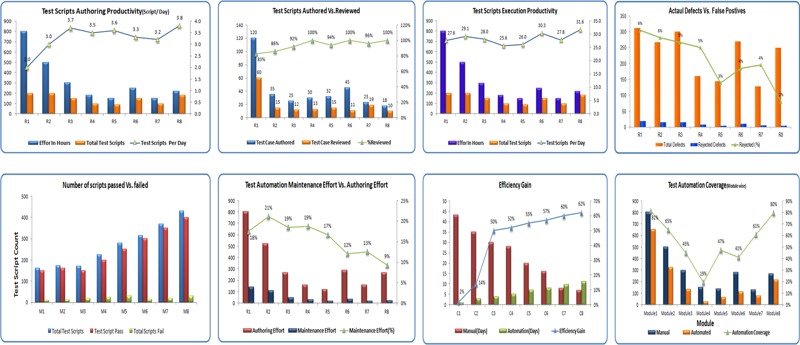
Test Automation Sample Dashboard

